Slide 1
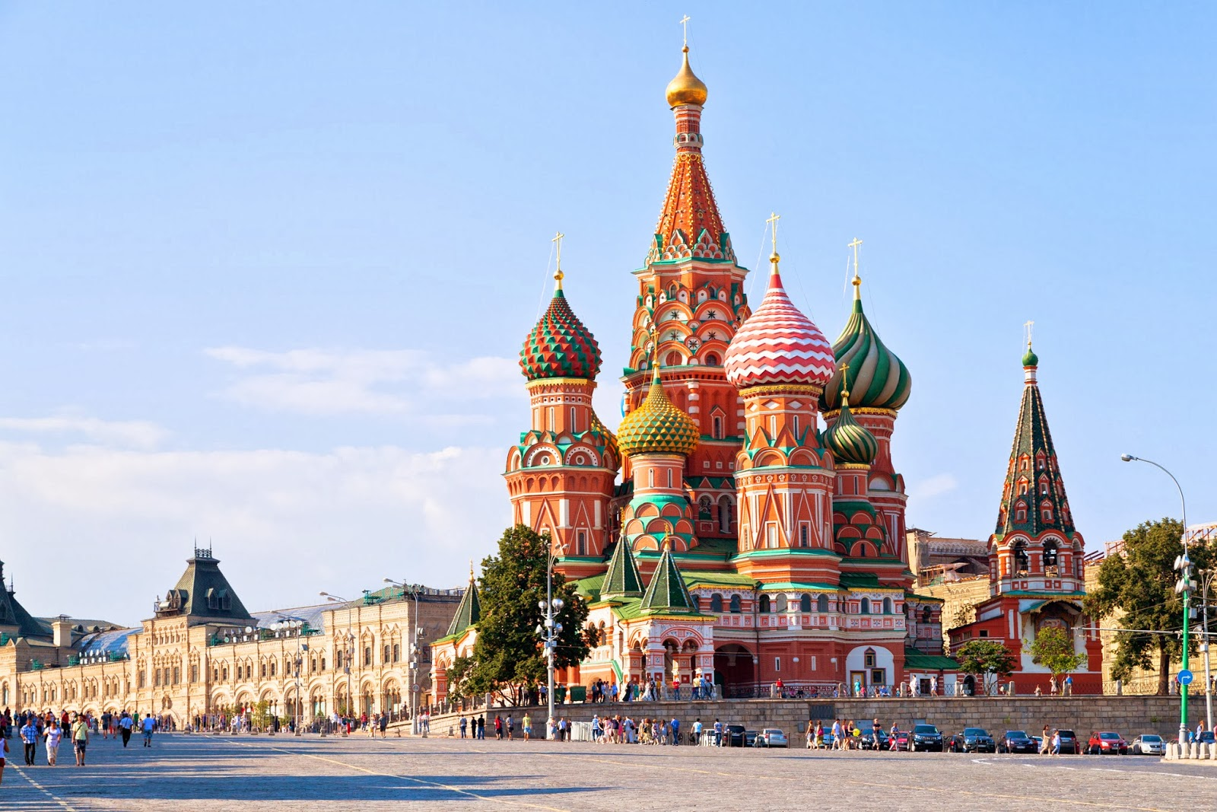

www.incredible-adventures.com
800-644-7382 or 941-346-2603
MAKS 2019
RUSSIAN AIR SHOW ADVENTURE
August 30 – September 3, 2019
Join Incredible Adventures for a VIP experience in Moscow, Russia. Tour, adventure and experience Moscow like never before.
Life is either an incredible adventure or nothing at all!
Tour Here…
Adventure includes guided tour of Red Square

Slide 2
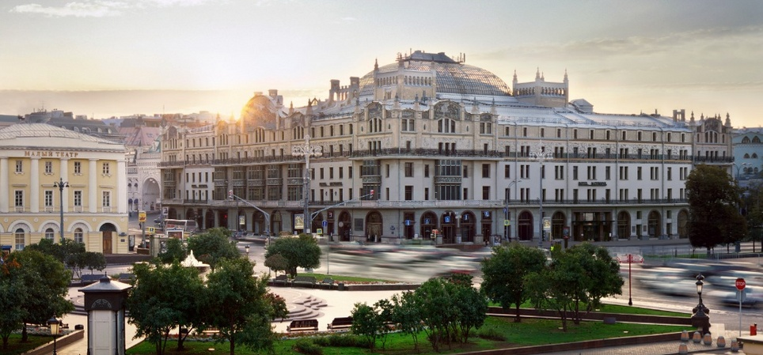
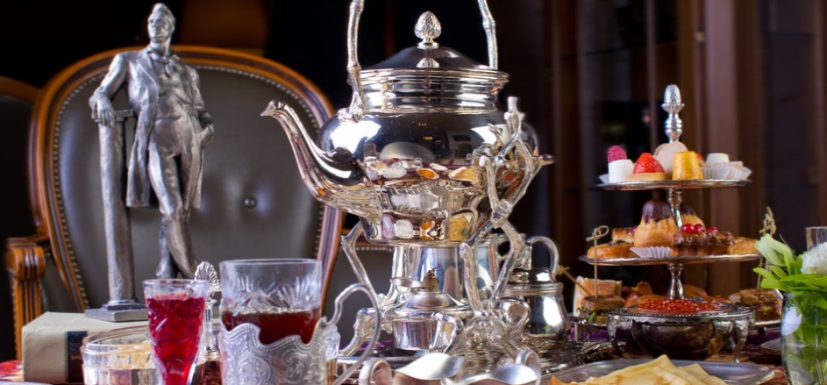
The Legendary Metropol Hotel
Included Accommodations: August 30, 31, Sept 1, Sept 2, 2019
Stay Here...

Slide 3
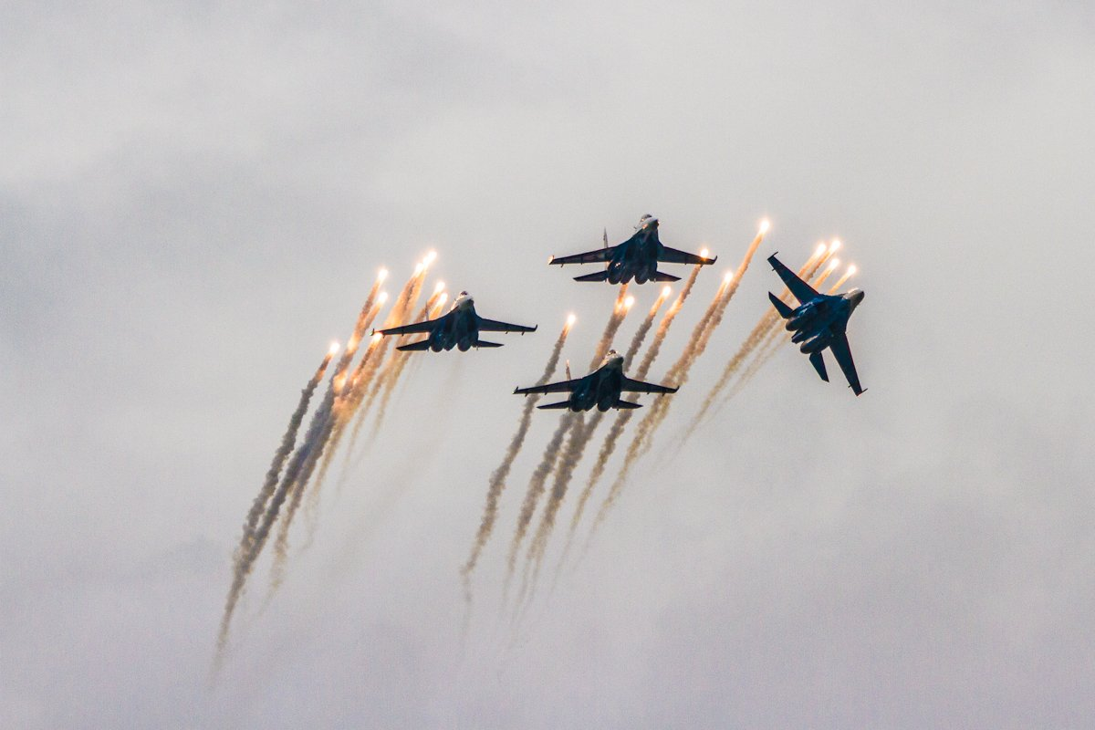
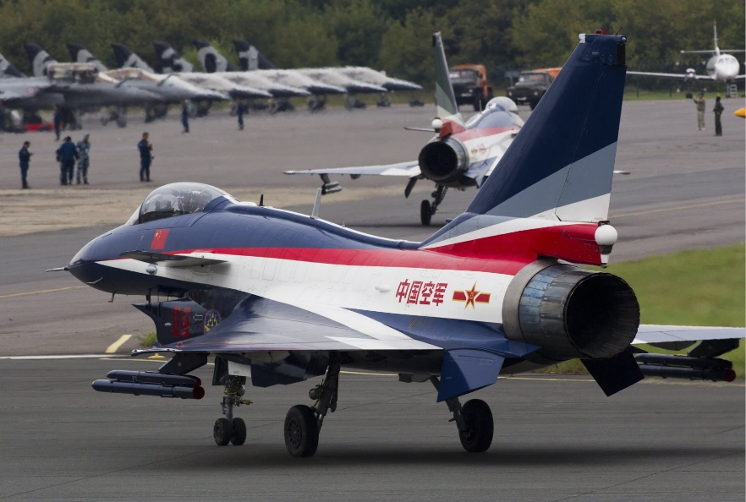
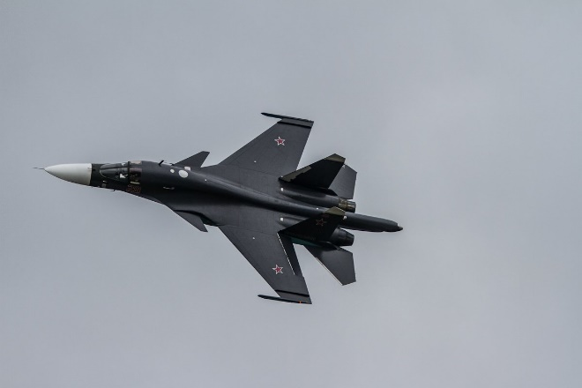
MAKS 2019Airshow Zhukovsky
Moscow Region, Russia
Package includes VIP Admission to MAKS on Saturday, August 31, 2019
Dream Here...

Slide 4
MAKS 2019 Air Show Adventure Includes:
VIP Air Show Admission (includes access to air-conditioned pavilion and special viewing area
Airport Transfers (round trip)
Welcome dinner / cocktail reception
Assistance with Visa forms
Accommodations at 5-Star Metropol Hotel for four nights. (Includes breakfast.)
VIP Walking Tour of Moscow (includes lunch)
Price: $4950 US
www.incredible-adventures.com
800-644-7382 or 941-346-2603

Slide 5
MAKS 2019 – Itinerary
Friday, August 30 - Arrive Moscow. Met at airport by Incredible Adventures representative and transported to historic Metropol Hotel, located an easy walk from Red Square. Welcome Dinner.
Saturday, August 31 – Breakfast in hotel. Accompany guide to MAKS 2019 for day of exploring. Watch aerial shows from the comfort of the VIP Pavilion.
Sunday, September 1 – Breakfast in hotel. Walking tour with guide & lunch. Rest of day free to explore Moscow.
Monday, September 2 – Breakfast in hotel. Free day, or add one or more great adventure options, for an additional cost.
Tuesday, September 3 – Breakfast in hotel. Transportation to airport for departure.
www.incredible-adventures.com
800-644-7382 or 941-346-2603

Slide 6
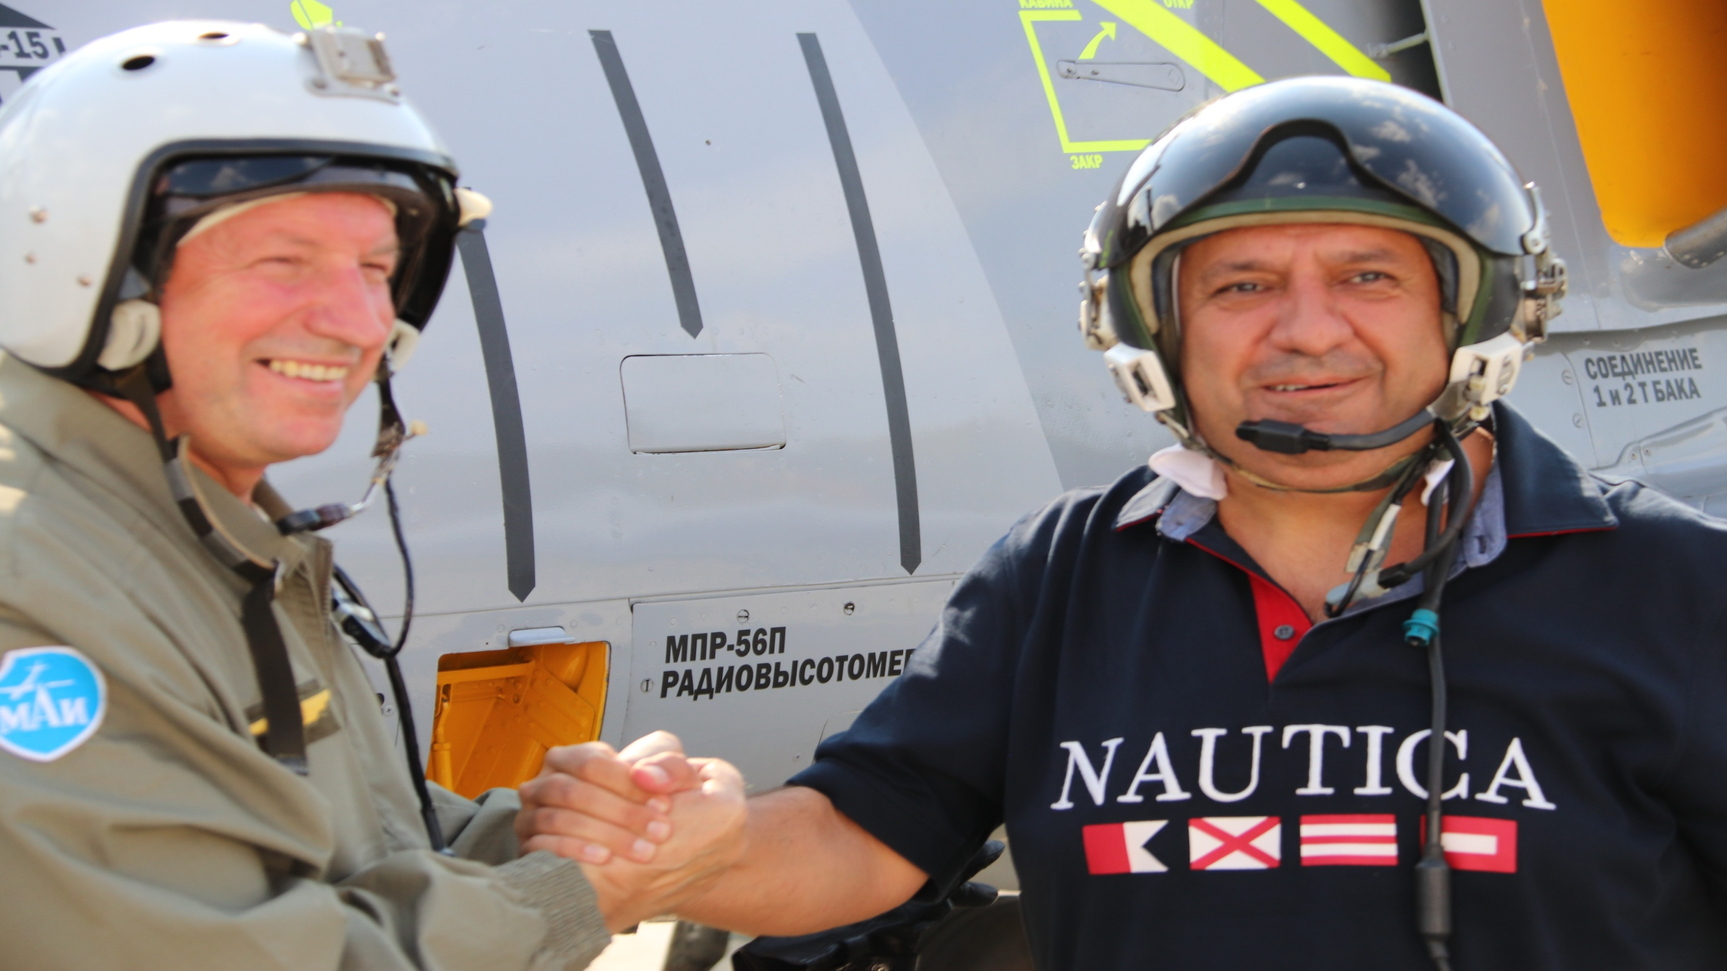
Customize Your MAKS 2019 Air Show Adventure With One or More Adventure Add-Ons

Slide 7
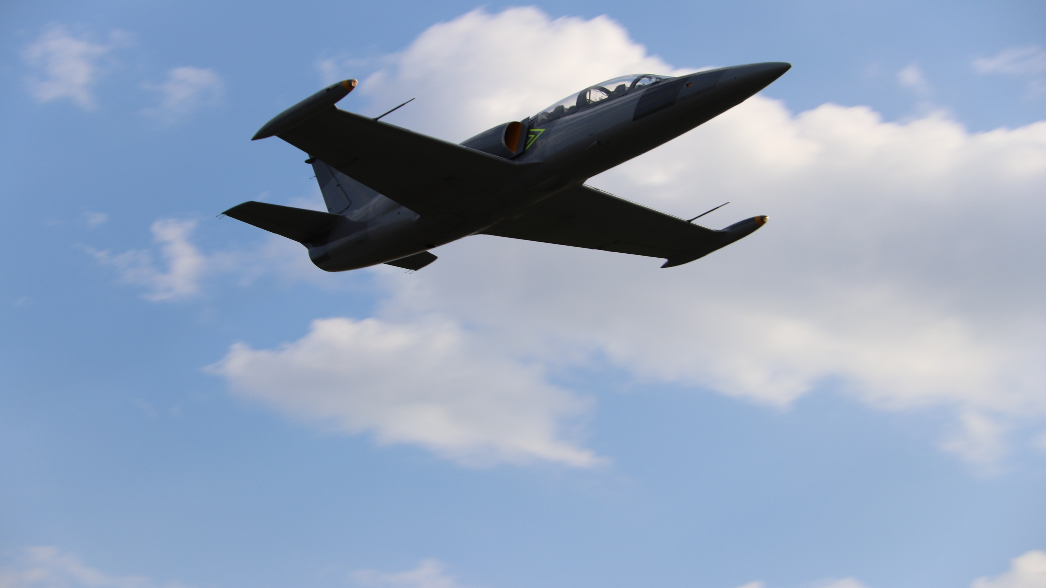
Fly Here...
Optional Add On - Advanced L-39 Fighter Jet Flight with multi-camera video: $4950 US
Additional flight options available.
www.incredible-adventures.com

Slide 8
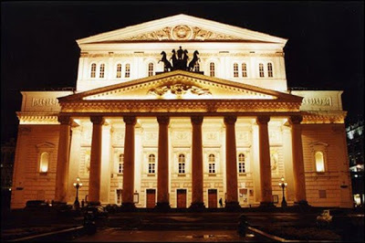
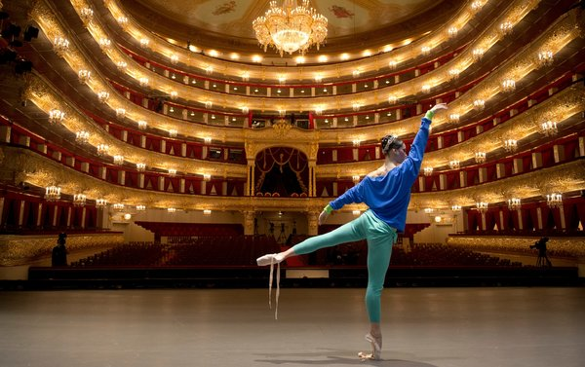
Bolshoi Ballet
Optional Add-On Activity
Call for Pricing
Visit Here...

Slide 9
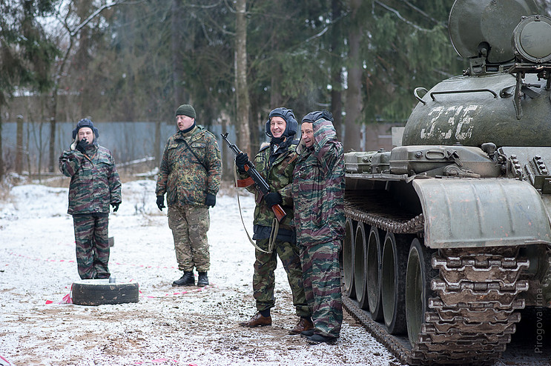
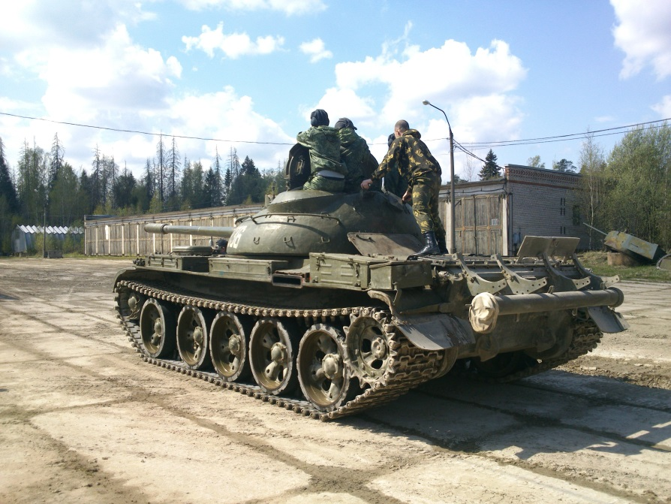
Play Here...
Russian Tank Firing Adventure
Optional Add-On Activity – Call for pricing

Slide 10
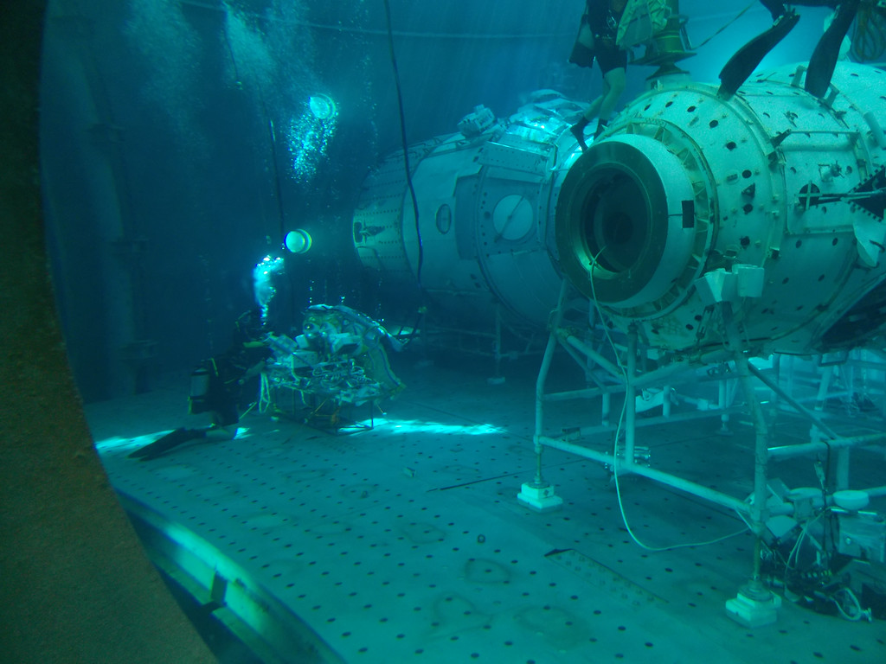
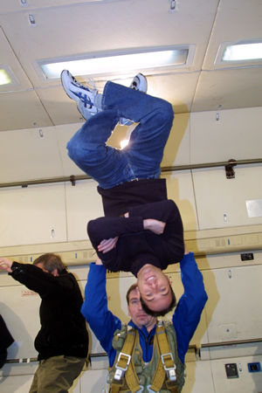
Train Here...
Gagarin Cosmonaut Training Center – Star City
Optional Add –On – Cosmonaut Training at Star City – Call for Pricing

Slide 11

“Life is either an incredible adventure or nothing at all.”
- Inspired by Helen Keller
www.incredible-adventures.com
800-644-7382 or 941-346-2603
Copyright Incredible Adventures / IA Worldwide, Inc. - 2019

